Slide 1
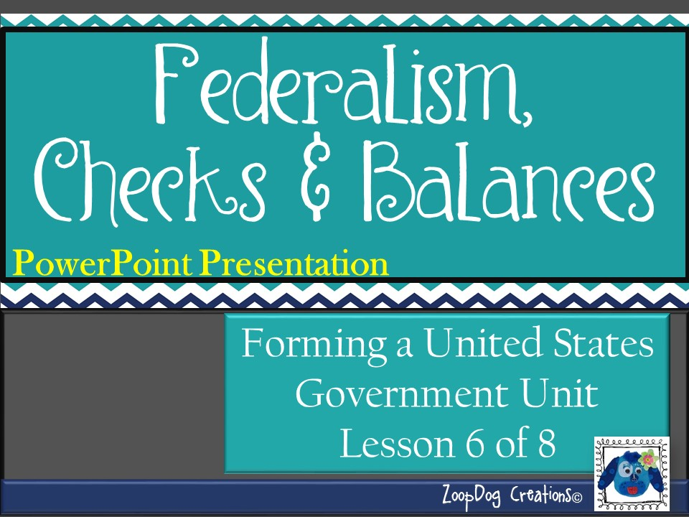

Slide 2
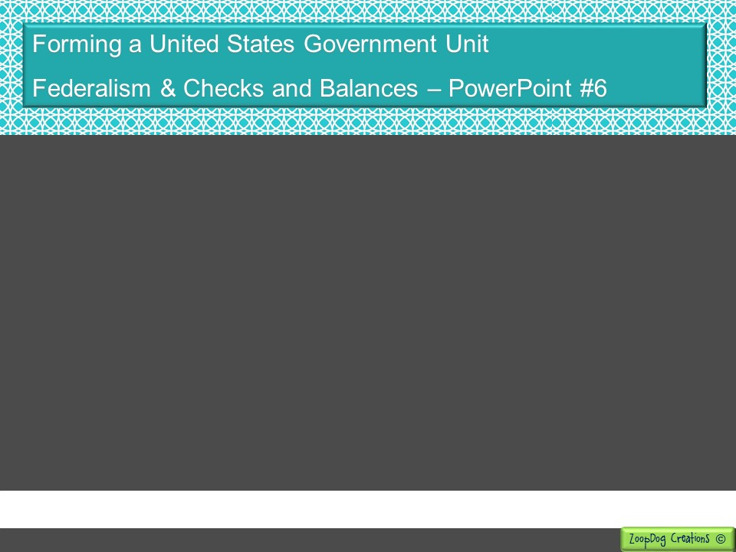
VOCABULARY Federalism – Checks and Balances – Veto – Impeach – Tyranny –

Slide 3
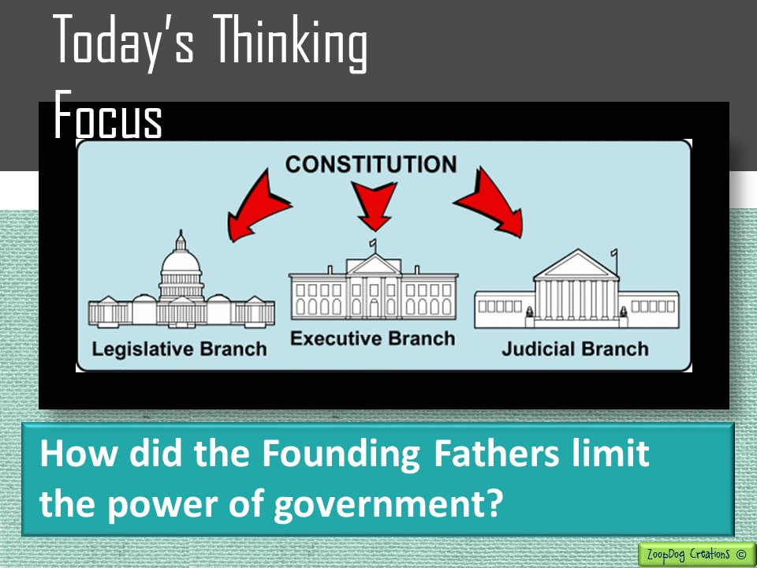

Slide 4

And the story continues . . .
Continental Congress tries to create a new government, but states fight over how it should be structured.
The Virginia and New Jersey Plans are created.
The Great Compromise created by Roger Sherman finally settles the dispute.
Northern and southern states begin fighting over slavery. The Three-Fifths Compromise allows slaves to be counted as 3/5th of a person.
The Founding Father’s took ideas from the Magna Carta, Locke, the Mayflower Compact and others to create the U.S. Constitution.

Slide 5
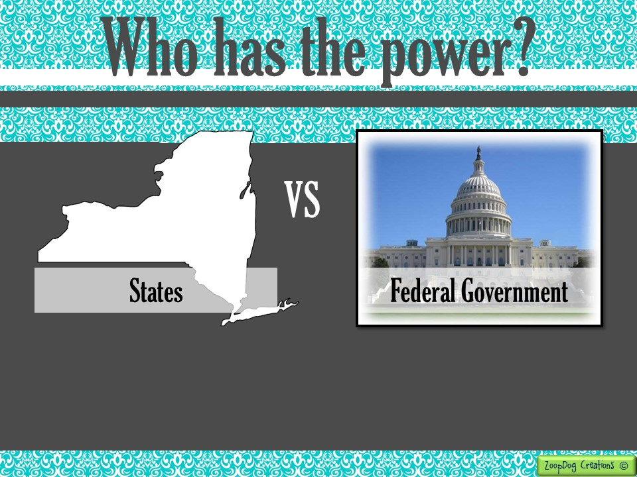
Now that the states have given up some of their power and the federal government has gained some power, WHO has the POWER?

Slide 6
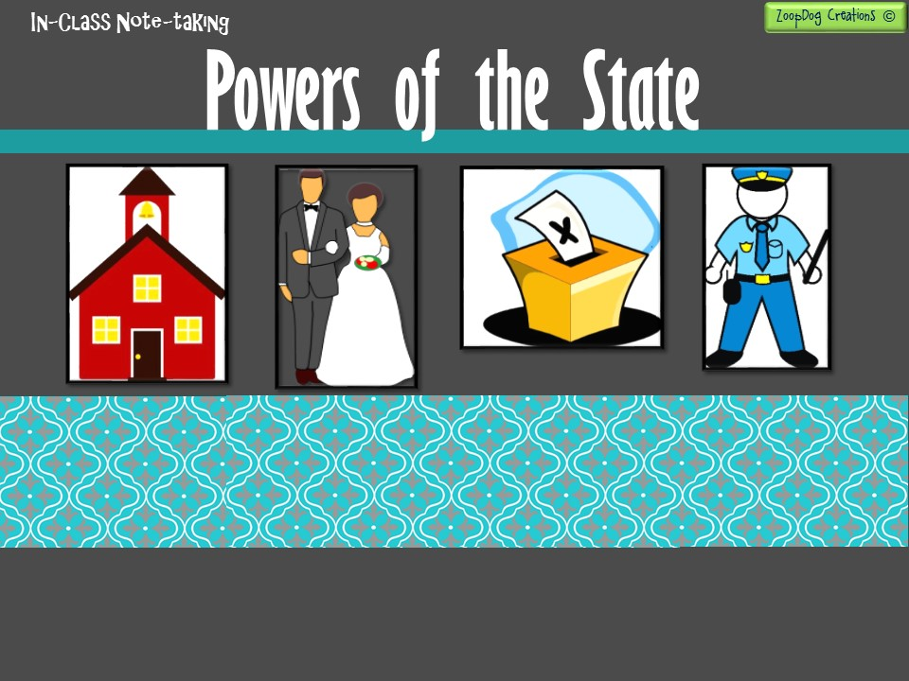
Control trade within states
Establish and maintain schools
Establish local government
Make laws about marriage and divorce
Conduct elections
Provide for public safety (police, firefighters, etc.)

Slide 7
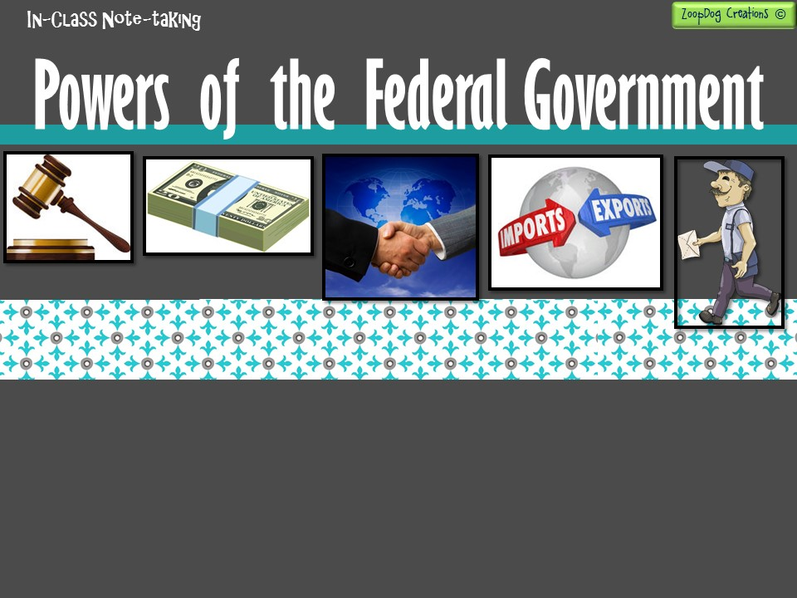
Control trade between the states and with other nations.
Create and maintain armed forces (army, navy, air force, etc.)
Create foreign policy (how we treat other nations)
Establish postal systems
Create federal courts (appoint judges, etc.)
Coin money
Declare war!
Admit new states

Slide 8
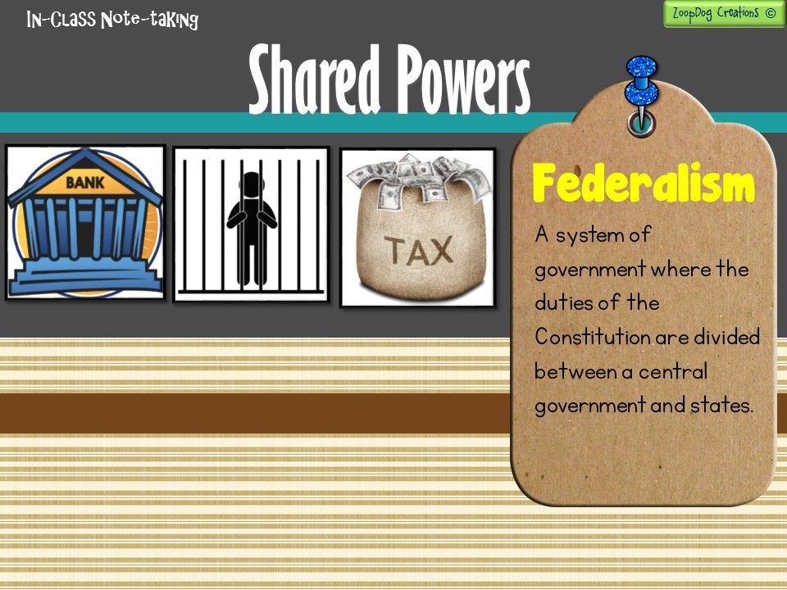
Borrow money
Raise taxes
Provide for public welfare
Administer criminal justice
Charter banks

Slide 9
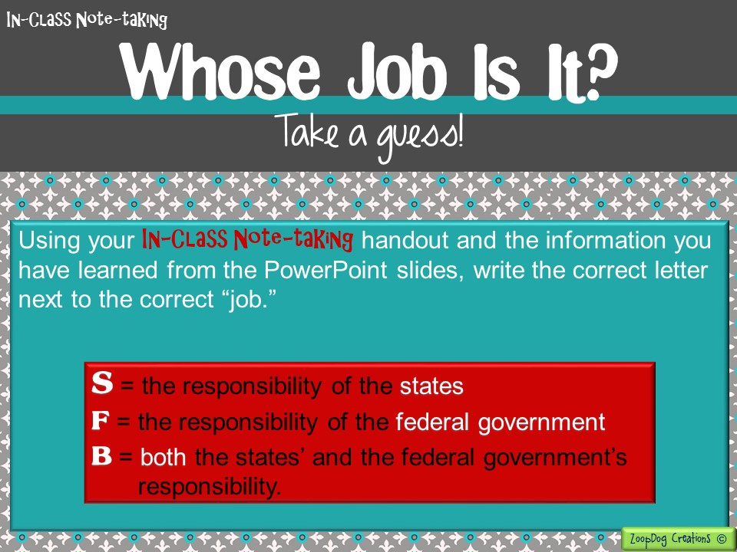

Slide 10
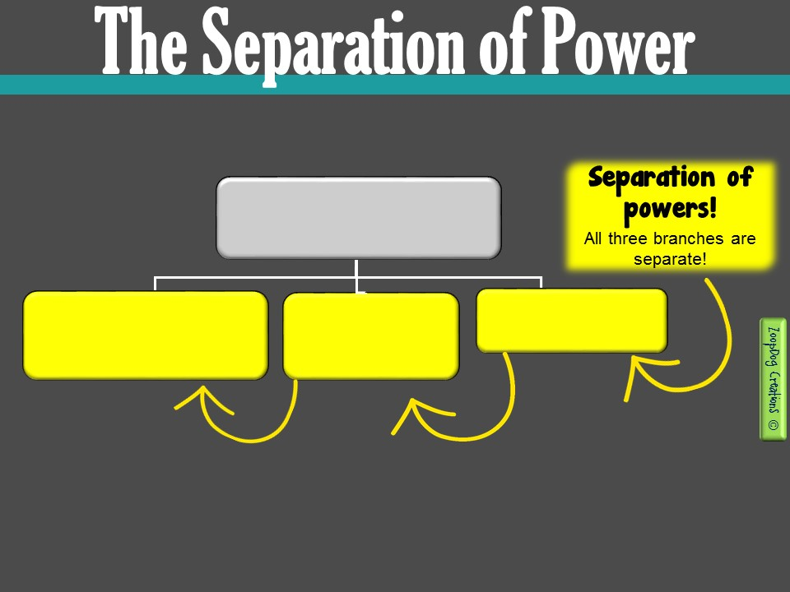
The framers relied on Montesquieu’s idea of separation of powers to prevent tyranny.
Federal Government
Legislative Branch
“Congress”
- Creates and passes the laws -
Executive Branch
- Carries out the laws -
Judicial Branch
- Decides if laws are fair -
Tyranny - a cruel or unjust government or rule.
Separation of power - A fundamental principle of the United States government, whereby powers and responsibilities are divided among the Legislative branch, Executive branch, and Judicial branch.

Slide 11
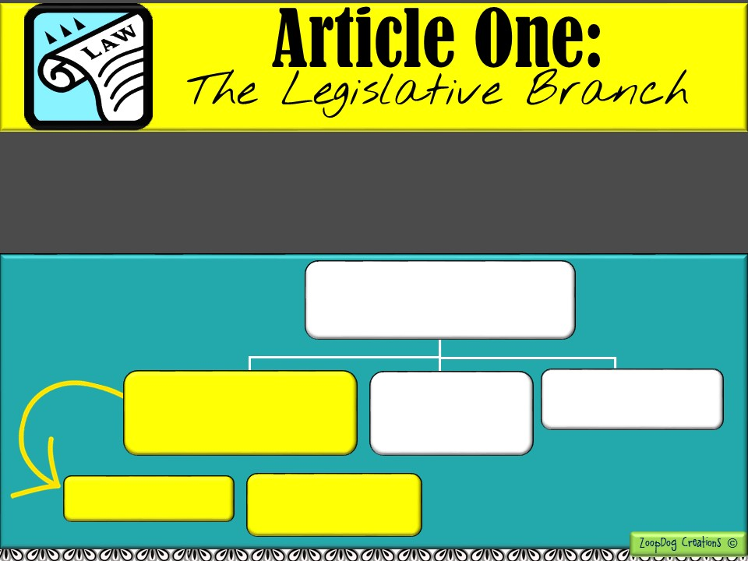
The Legislative branch is also called “Congress.”
The Legislative branch’s main function is to make laws.
Congress = House of Representatives and Senate.
Federal Government
Legislative Branch
“Congress”
- Creates and passes the laws -
Executive Branch
- Carries out the laws -
Judicial Branch
- Decides if laws are fair -
Upper House
“The Senate”
Lower House
“House of Representatives”

Slide 12
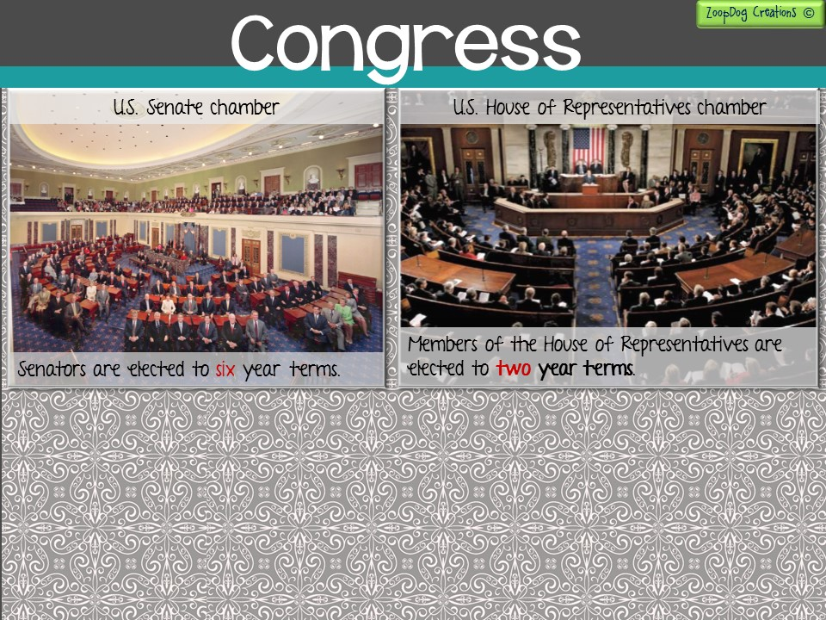
Article One of the Constitution lays out the powers of Congress.
The power to collect taxes
Regulate foreign and interstate (between states) trade
Declare War!
Raise and support armies

Slide 13
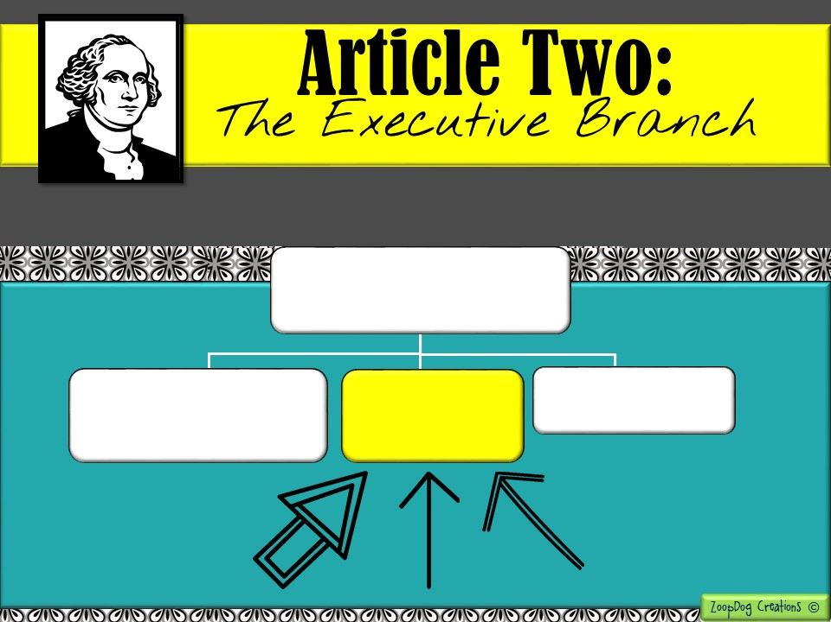
Federal Government
Legislative Branch
“Congress”
- Creates and passes the laws -
Executive Branch
- Carries out the laws -
Judicial Branch
- Decides if laws are fair -

Slide 14
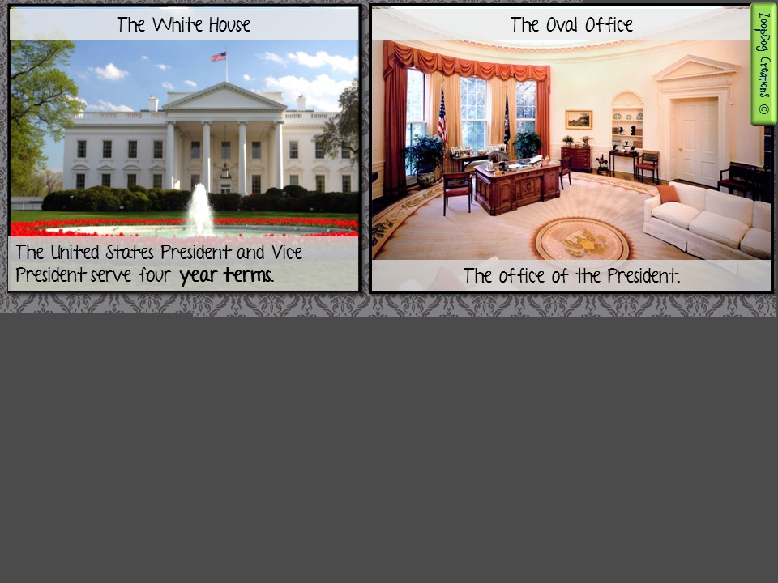
Article two of the Constitution lays out the powers of the Executive branch.
The Executive branch is headed by the President and includes the Vice President and any advisors.
The President is responsible for carrying out the laws passed by Congress.
The President is also Commander-in-Chief to the armed forces and is responsible for directing foreign relations.

Slide 15
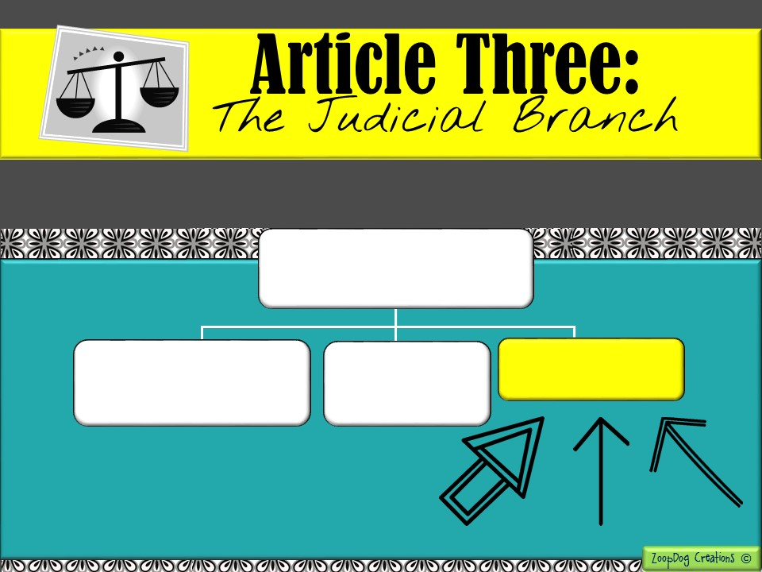
Federal Government
Legislative Branch
“Congress”
- Creates and passes the laws -
Executive Branch
- Carries out the laws -
Judicial Branch
- Decides if laws are fair -

Slide 16
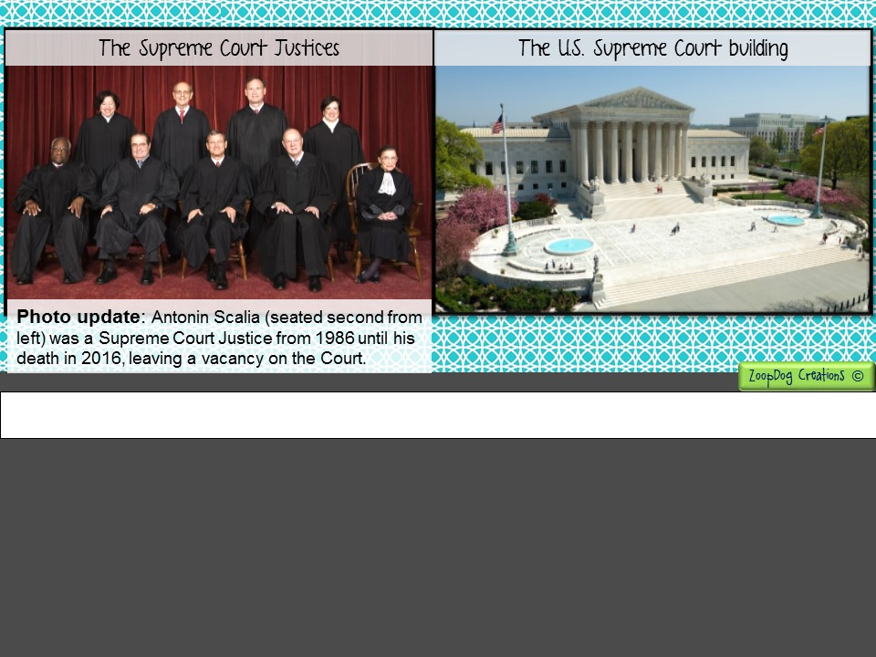
Article three of the Constitution lays out the powers of the Judicial branch.
The Supreme Court and other federal courts hear cases that involve the U.S. Constitution or any laws passed by Congress.
They also hear cases arising from disputes between two or more states.

Slide 17
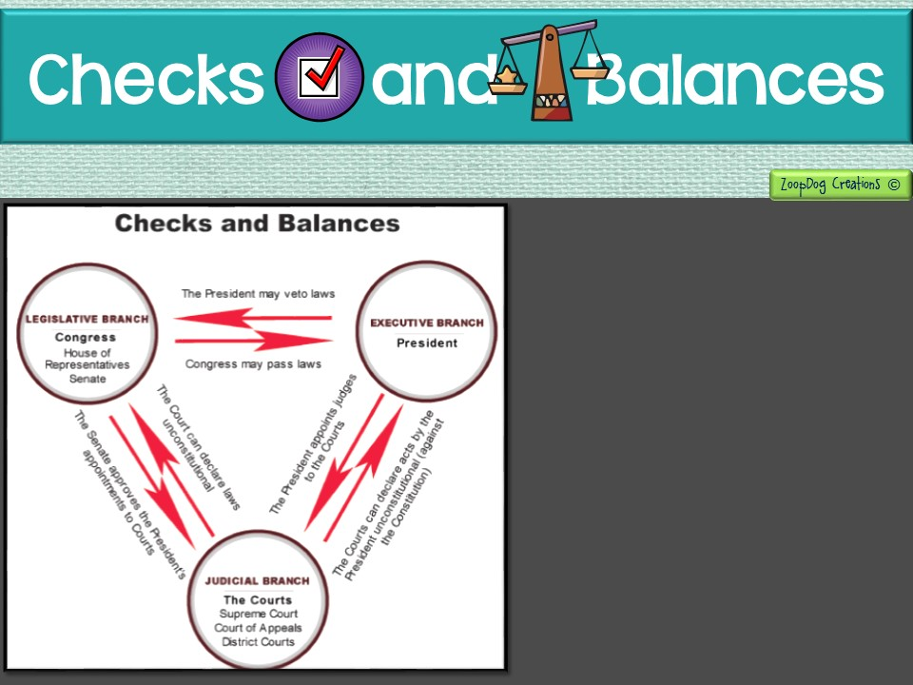
The Constitution set up a system of Checks and Balances.
Under this system, each branch of the federal government has some way to “check” or control the other two branches.
Checks and balances is yet another way to LIMIT THE POWER OF GOVERNMENT!

Slide 18
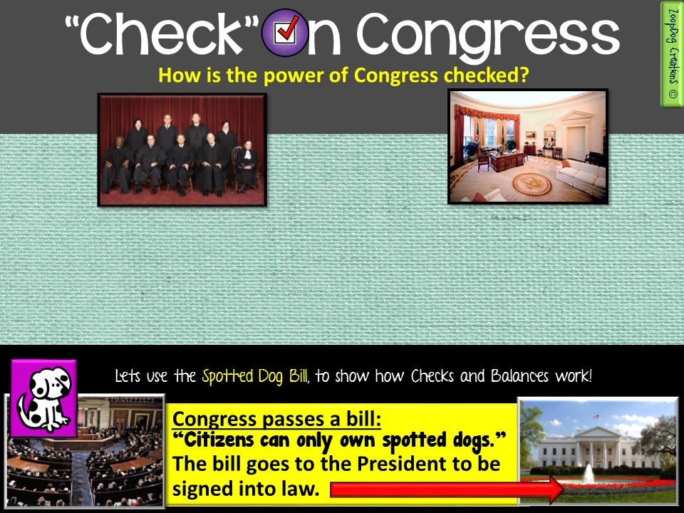
The Supreme Court can check the powers of Congress by reviewing the laws to make sure they are constitutional.
If the law violates the U.S. Constitution the court can declare it unconstitutional and throw it OUT!
The President can “check” Congress by vetoing (to reject) a bill.

Slide 19
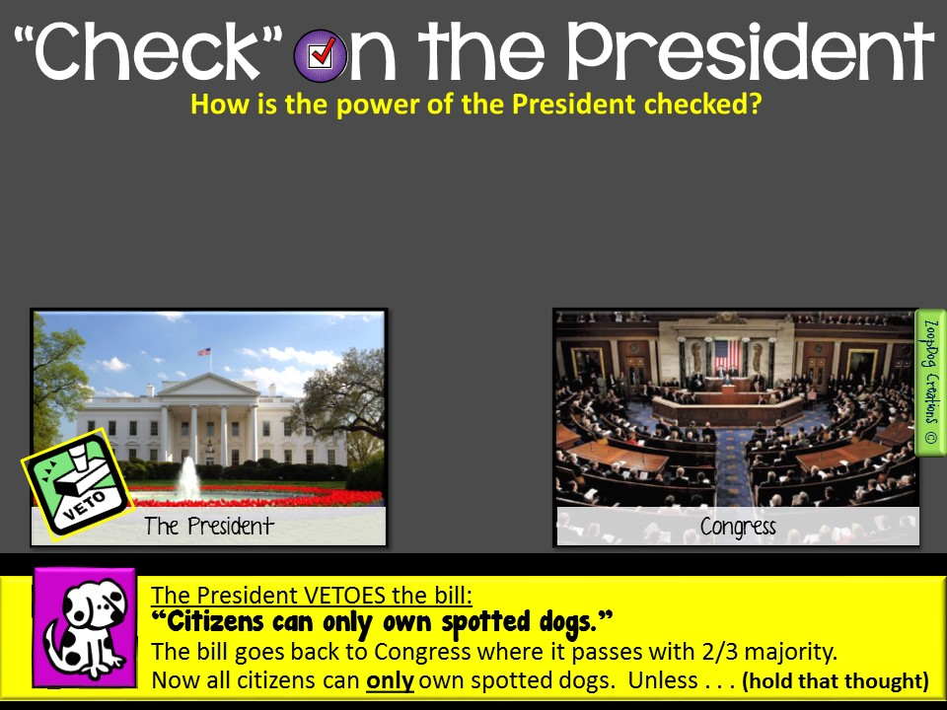
There is a way for a bill to become a law without the President’s signature:
  2/3 of both houses (Senate and House of Representatives) must vote for the vetoed bill to become a law.

Slide 20
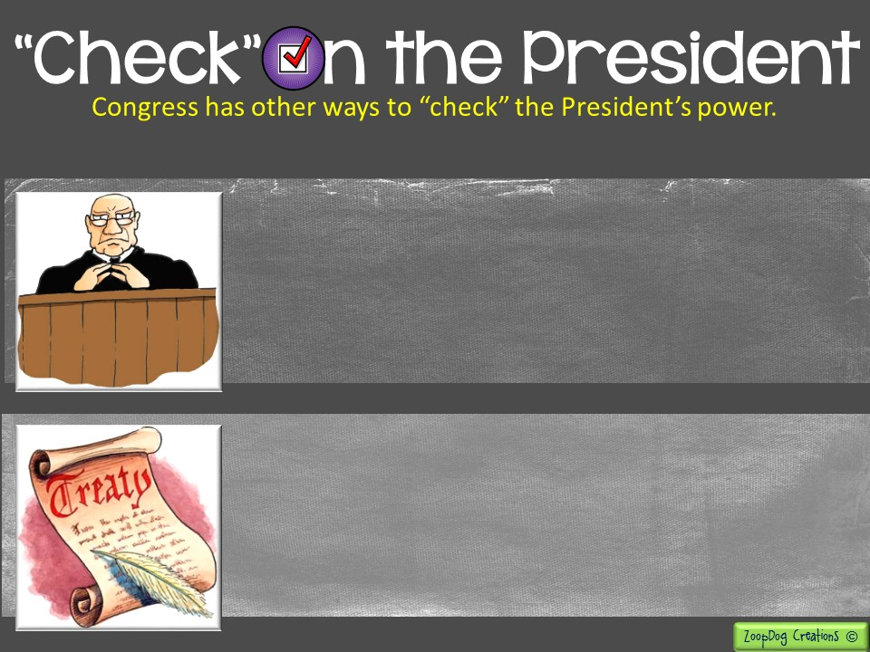
The President appoints officials such as ambassadors to foreign countries and federal judges.
The Senate must approve these people.
The President can negotiate treaties with other nations.
But . . . it can only become a treaty if 2/3 of the Senate approve it!

Slide 21
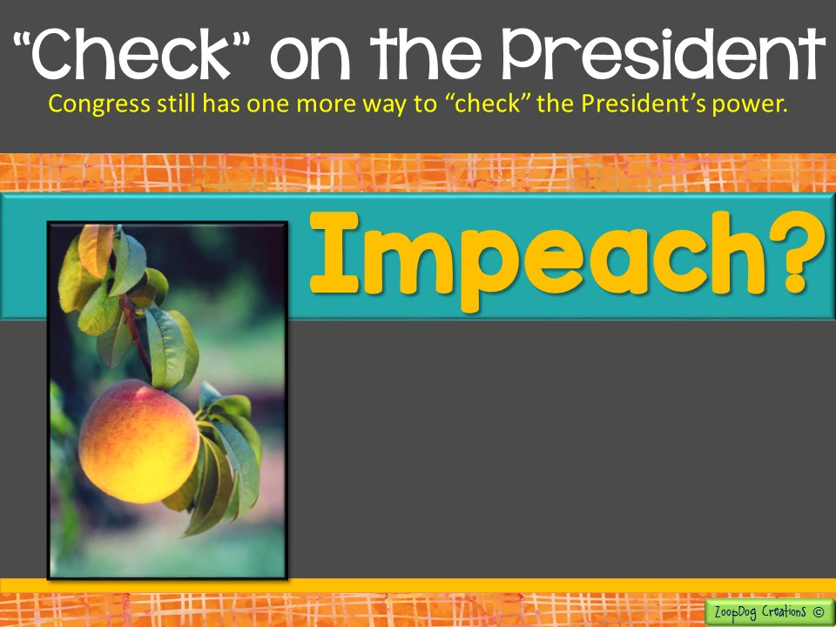
Did someone say peach?

Slide 22
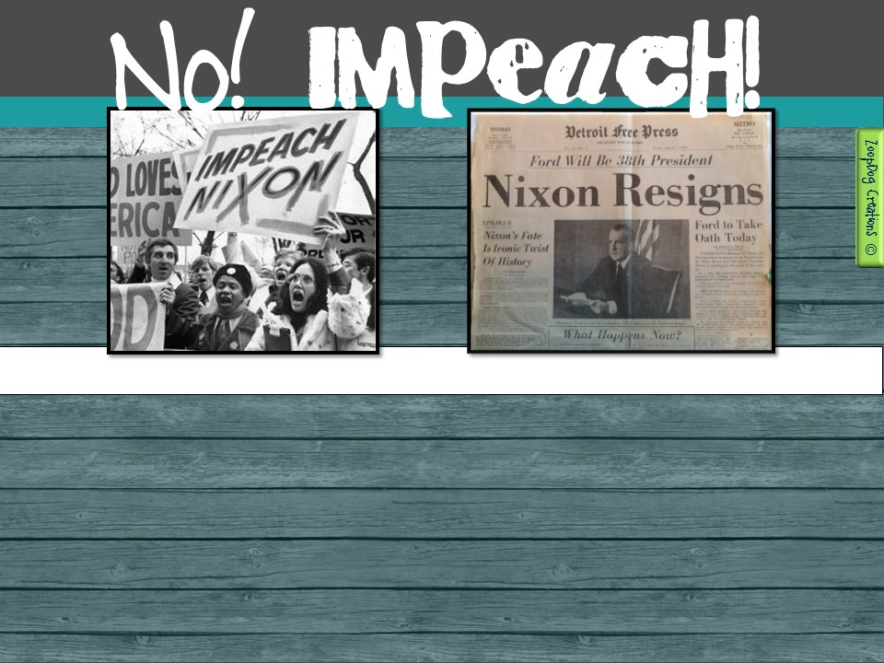
Impeach - a formal process in which an official is accused of unlawful activity, the outcome of which may include the removal of office as well as criminal or civil punishment.
Congress has the power to remove a president from office if it finds the president guilty of a crime or serious misbehavior.
If 2/3 of the Senate believe the president is guilty, he/she must leave office!

Slide 23
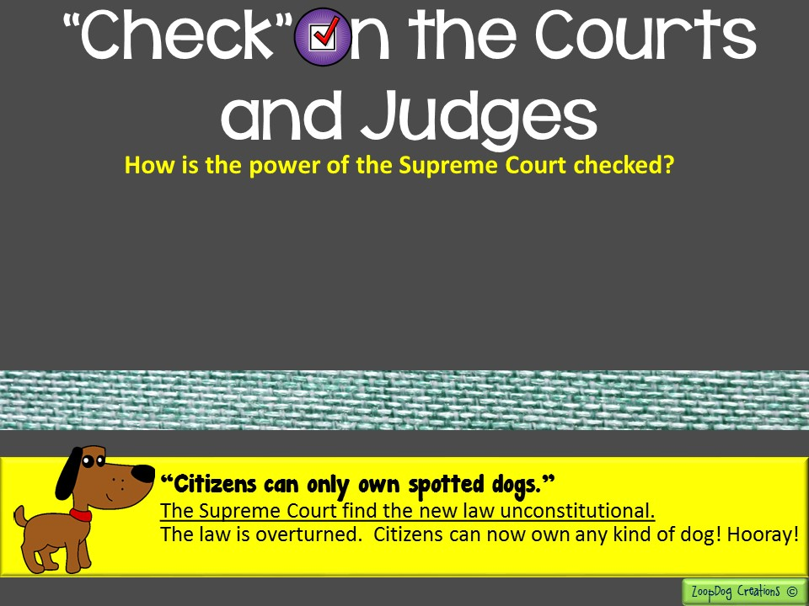
The president appoints judges, who must be approved by the Senate.
If judges misbehave, Congress may remove them from office.
Congress establishes the number of justices on the Supreme Court.
Congress can also propose changes to the Constitution and overturn the court.

Slide 25
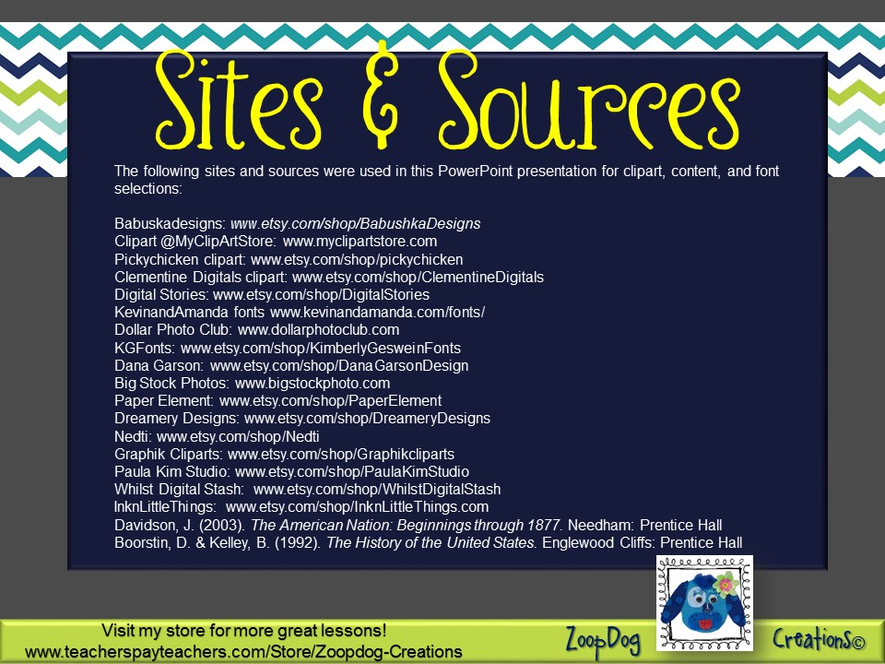

Slide 26
